Slide 1
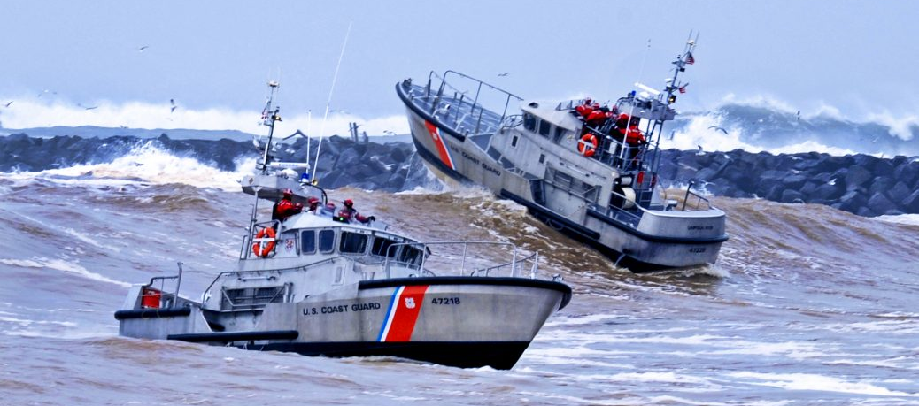
Pilot Program (Unit) Implementation
Notes:
Pilot Program (Unit) Implementation

Slide 2
Learning Objectives
Coast Guard Operational
Stress Control (CG -0SC )
DISCUSS the key elements needed to implement the E-OSC Program at the “deckplate” level
IDENTIFY and DISCUSS the importance of leadership endorsement
IDENTIFY and DISCUSS the E-OSC team
IDENTIFY and DISCUSS opportunities for command trainings
DISCUSS how to market and promote E-OSC throughout your unit
DISCUSS key elements of the E-OSC Pilot Program Evaluation (PE)
DISCUSS the Military Training Specialist’s (MTS) role in pilot support
Notes:
Learning Objectives
IDENTIFY and DISCUSS key elements to implement the E-OSC program at the “deckplate” level
IDENTIFY and DISCUSS the importance of leadership endorsement
IDENTIFY and DISCUSS the members of a E-OSC team
IDENTIFY and DISCUSS opportunities for command trainings
DISCUSS how to market and promote E-OSC throughout your command
DISCUSS the Military Training Specialist’s role in pilot support

Slide 3
Implementing E-OSC in the Unit
Coast Guard Operational
Stress Control (CG -0SC )
Leadership Endorsement
Set the tone
Team Development
Establish a multi-rate, rank and department team
Educate
Internal Command trainings
Incorporate
Marketing (POD notes, command events, etc.)
Inculcate
Embed the concept as a part of the culture.
Notes:
Implementing E-OSC in the Unit
Leadership Endorsement
- Set the tone
Establish a team
- Multi-rate, rank and department
Educate
- Command training sessions and outreach
Incorporate
- Marketing (POD notes, command events, etc.)
Inculcate
Embed the concept as a part of the culture.
- Speak to the E-OSC concepts. Practice self-care and resilience. Support using the concepts of E-OSC

Slide 4
Leadership Endorsement
Coast Guard Operational
Stress Control (CG -0SC )
In order to sustain this program it has to be ingrained within the culture of the command:
Provide an overview of E-OSC components and goals to TRIAD, Wardroom, CPO and FCPO Messes
Every Sailor, Every Day requires endorsement at every level
Supported, endorsed, and promoted by the entire department chain of command, from WCS to Department Head
Notes:
Leadership Endorsement
In order to sustain this program it has to be ingrained within the culture of the command:
Provide an overview of E-OSC components and goals to TRIAD, Wardroom, CPO and FCPO Messes
Every Sailor, Every Day requires endorsement at every level
Supported, endorsed, and promoted by the entire department chain of command, from WCS to Department Head

Slide 5
Team Development
Coast Guard Operational
Stress Control (CG -0SC )
E-OSC program sustainment requires all groups within the command to serve as force multipliers:
Team Leader (TL) & Assistant Team Leader (ATL):
E-OSC Team Leader: E7 or above (attend a E-OSC Trainer Course)
E-OSC Assistant Team Leader: E6 or above (attend a E-OSC Trainer Course)
Team Members:
Minimum E5 rank (Trained at unit by Team Leaders)
Multi-rank, rate, department/division - Officers, Chiefs, junior enlisted
Enough members to support the command E-OSC training plan, Buddy Care, Unit Assessment & SoM
CRT specifically to support Buddy Care component
IT POC for SoM installation/facilitation and support
Notes:
Team Development
E-OSC program sustainment requires all groups within the command to serve as force multipliers:
Establish a Team Leader (TL) & Assistant Team Leader (ATL)
E-OSC Team Leader: E7 or above (attend a E-OSC Trainer Course)
E-OSC Assistant Team Leader: E6 or above (attend a E-OSC Trainer Course)
E-OSC Team Members: Minimum E5 rank (Trained at unit by Team Leaders)
Team Members- Multi-rank, rate, department/division - Officers, Chiefs, junior enlisted
Enough members to support the command E-OSC training plan, Buddy Care, Unit Assessment & SoM
Include as a part of Health Promotion, CFL, DAPA, SAPR, FAP, SP, CMEO, MWR
CRT specifically to support Buddy Care component

Slide 6
Educate: Command Trainings
Coast Guard Operational
Stress Control (CG -0SC )
Crew/Command Training: Stress & Resilience, Self-Care (resilience/toughness) principles (6-8 hours)
“Deckplate Extenders”: Wardroom, CPO Mess, FCPO Mess- Minimum requirement (to understand and support E-OSC program) includes overview of SoM, Buddy Care & Unit Assessment, COSFA, Core Leader Functions- (4-6 hours)
Train CRT Members in Buddy Care (1 hour)
Buddy Care, Stress-o-Meter (SoM), and Unit Assessment
Notes:
Educate: Command Trainings
Crew/Command Training: Stress & Resilience, Self-Care (resilience/toughness) principles (6-8 hours)
“Deckplate Extenders”: Wardroom, CPO Mess, FCPO Mess- Minimum requirement (to understand and support E-OSC program) includes overview of SoM, Buddy Care & Unit Assessment, COSFA, Core Leader Functions- (4-6 hours)
Train CRT Members in Buddy Care (1 hour)
Buddy Care, Stress-o-Meter (SoM), and Unit Assessment

Slide 7
E-OSC Course Modules
Coast Guard Operational
Stress Control (CG -0SC )
E-OSC ROLE/MODULE | 1 | 2 | 3 | 4 | 5 | 6 | 7 | 8 | 9 | 10 | 11 | 12 | 13 | 14 | 15
TEAM LEADER/AST TEAM LDR | X | X | X | X | X | X | X | X | X | X | X | X | X | X | X
TEAM MEMBER |  | X | X |  | X |  | X | X | X | X | X | OV | OV | OV
BUDDY CARE NETWORK/CRT |  |  |  |  |  |  |  |  |  |  | X |  | X
DECKPLATE EXTENDERS |  |  |  |  |  |  |  |  |  | OV | OV | OV | OV | OV
COMMAND TRAINING |  | X | X |  | X |  | X | X | X
Module 1: Course Overview & Introduction
Module 2: Stress & Resilience
Module 3: Mindfulness
Module 4: Navy Values & A Culture of Excellence
Module 5: Valued Living
Module 6: Emotional Intellegence (EQ)
Module 7: Flexible Thinking
Module 8: Healthy Behaviors
Module 9: Problem Solving
Module 10: COSFA
Module 11: Buddy Care
Module 12: Core Leader Functions
Module 13: Unit Assessment
Module 14: SoM
Module 15: Program Implementation
OV = Overview
Notes:
E-OSC Course Modules

Slide 8
Incorporate: Marketing E-OSC
Coast Guard Operational
Stress Control (CG -0SC )
POD notes that describe they key components of E-OSC
Post E-OSC material throughout command
Site TV, health fairs, Safety Standdowns
Align E-OSC components with other programs (PRP, Pastoral Care, MWR, DAPA, SAPR, FAP, CSADD, Sailor 360)
Include as a part of Health Promotion, CFL, DAPA, SAPR, FAP, SP, CMEO, MWR
Notes:
Incorporate: Marketing E-OSC
POD notes that describe they Key Components of E-OSC
Post E-OSC material throughout command
Site TV, Health fairs, Safety Standdowns
Align E-OSC components with other programs (PRP, Pastoral care, MWR, DAPA, SAPR, FAP, CSADD)

Slide 9
Inculcate: Embed the Concept
Coast Guard Operational
Stress Control (CG -0SC )
Command Indoctrination (INDOC)
Introduce E-OSC, show E-OSC Videos
Department/Division, Duty Section, Quarters
Wardroom, CPO Mess, FCPO
Conduits to training and promoting E-OSC components
Safety Standdown
Sailor 360, Command PT, MWR events
Short, consistent, continuous and specific trainings on E-OSC components.
This is not annual GMT training!
Notes:
Inculcate: Embed the Concept
Command Indoctrination (INDOC)
Introduce E-OSC, describe purpose, and general components
Department/Division
“Wardroom”, CPO Mess, FCPO, CSADD
Conduit to training and promoting E-OSC components
Safety Standdown
Sailor 360, Command PT, MWR events
Short, consistent, continuous and specific trainings on E-OSC components This is not annual GMT training!

Slide 10
Pilot Program Evaluation (PE)
Coast Guard Operational
Stress Control (CG -0SC )
The Program Evaluation (PE) element is to determine feasibility and fidelity in establishing a unit level E-OSC program, and the value of this program on Sailor readiness.
Tools & Metrics:
Servicemember (SVM) Metrics Survey (SMS): (10-15 minutes; paper/pencil or electronic; at unit): Will be completed by SVMs.
Program Status Survey (PSS): (paper/pencil or electronic; at unit): Will be completed by E-OSC Team Leader.
Focus Groups: NCCOSC/N17 qualitative assessment of command E-OSC Program; Will be conducted onsite at 6 months.
Unit (command) Organizational Metrics: Will be compiled and submitted by E-OSC Team Lead at Time 1 (Baseline-previous year), and 12 months).
Both SVM & PSS completed at Time 1 (T1) (Baseline), T2 (4 months), T3 (8 months), and T4 (12 months).
Notes:
Pilot Program Evaluation (PE)
Assessment Tools and Metrics:
Servicemember (SVM) Metrics Survey (SMS): (10-15 minutes; paper/pencil; at unit): Will be completed by SVMs at Time 1 (Baseline), Time 2 (4 months), Time 3 (8 months) and Time 4 (12 months).
General Information (e.g., command/UIC, rank, Department)
Resilience
Toughness
Connectedness
Trust in Unit & Leadership
Perceived Stress
Help Seeking Support
Stress Management
Healthy Behaviors
Unit Signature Behaviors
Practice of E-OSC Skills
Program Status Survey (PSS): (paper/pencil or electronic; at unit): Will be completed by CRT E-OSC Lead at Time 1 (Baseline), Time 2 (4 months), Time 3 (8 months), and Time 4 (12 months).
Questionnaire for E-OSC Program penetration data, such as number of E-OSC trainings, number of topics taught and number of Buddy Care supports.
Focus Groups: NCCOSC/N17 qualitative assessment of command E-OSC Program; Will be conducted onsite at 6 months.
In person Focus Group interviews with E-OSC team
In person Focus Group interviews with SVMs
Unit (command) Organizational Metrics: Will be compiled and submitted by E-OSC Team Lead at Time 1 (Baseline-previous year), and 12 months).
Retention data
Advancement/Promotion rates
Unit awards
Major events: Leadership change, major inspections/certifications, etc.
PRT/BCA data
ARIs, DUIs, NJPs, ADSEPs
DEOCS (Command Climate Survey) & Health of the Force (HoF) Survey
ELP Prevention and Divisional Scorecards
E-OSC post training instructor and participant surveys
Unit (Command) Level of Effort:
Implement E-OSC Program
Endorse/Champion E-OSC SVM Metrics Survey (baseline, 4 months, 8 months, and 12 months)
Complete Program Status Survey (baseline, 4 months, 8 months, and 12 months)
Endorse/Support Focus Groups (6 months)
Compile and submit command data metrics (baseline- previous year), and 12 months)

Slide 11
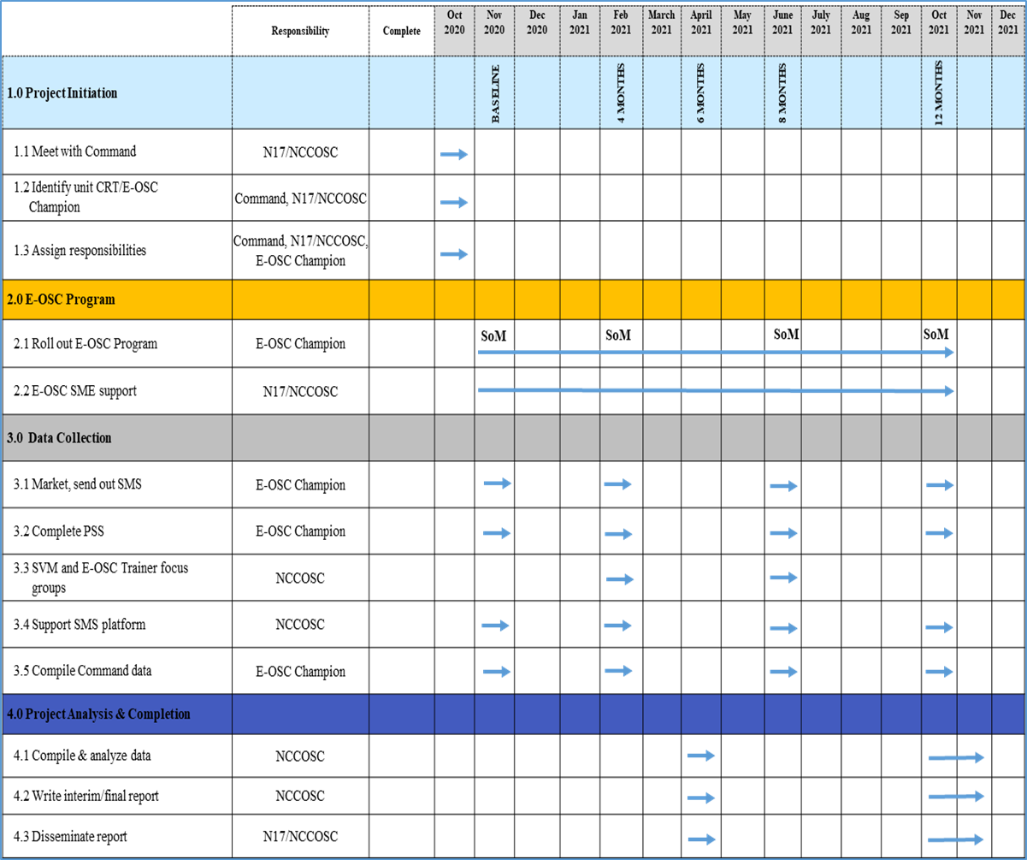
Program Evaluation (PE) POA&M
Coast Guard Operational
Stress Control (CG -0SC )
Notes:
Program Evaluation (PE) POA&M

Slide 12
MTS Pilot Support
Coast Guard Operational
Stress Control (CG -0SC )
Military Training Specialist’s (MTS) will support:
Training of E-OSC Team Leaders, Assistant Team Leader, & Team Members
Establishment of Command E-OSC Team Members
Development of command E-OSC Program implementation plan
Consultation and will determine and document best practices
Buddy Care, Unit Assessments, & SoM (to include installation)
Program Evaluation
Collect training, UA, Buddy Care, SoM data & Post Training Surveys
Support/promote completion of SMS and Focus Groups
Coordination of meetings with E-OSC TLs (as appropriate)
Meet/brief with Command TRIAD- Program status update/support as appropriate
Notes:
MTS Pilot Support
Military Training Specialist’s (MTS) will support:
Training of E-OSC Team Leaders, Assistant Team Leader, & Team Members
Establishment of Command E-OSC Team Members
Development of command E-OSC Program implementation plan
Consultation and will determine and document best practices
Buddy Care, Unit Assessments, & SoM (to include installation)
Program Evaluation
Collect training, UA, Buddy Care, SoM data & Post Training Surveys
Support/promote completion of SMS and Focus Groups
Coordination of meetings with E-OSC TLs (as appropriate)
Meet/brief with Command TRIAD- Program status update/support as appropriate

